Slide 1
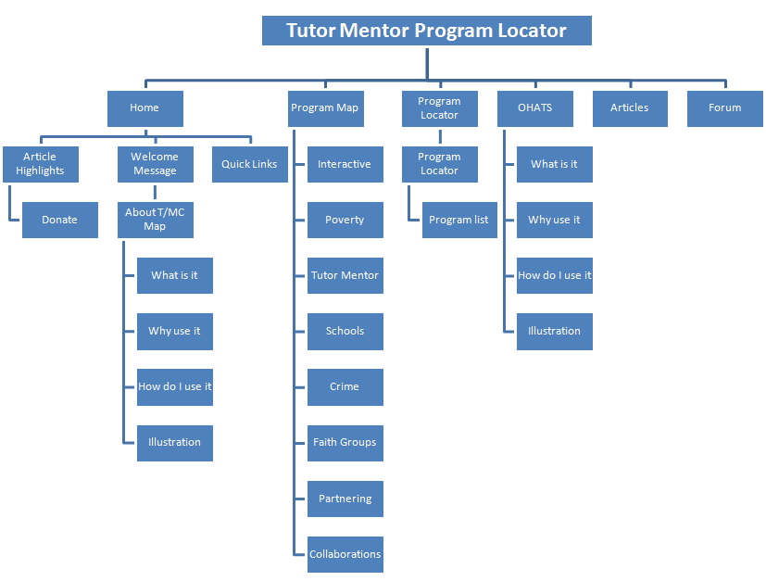
I think this shows an entire new web site. That’s not what we want. We want an interactive Map that is one of the resources of the Program Locator. As a result of this work, we may need to rebuild the program locator to look like this.
The pages following show my idea of how the pages you are building should flow, from the first to the third, with many additional sub pages.

Slide 2
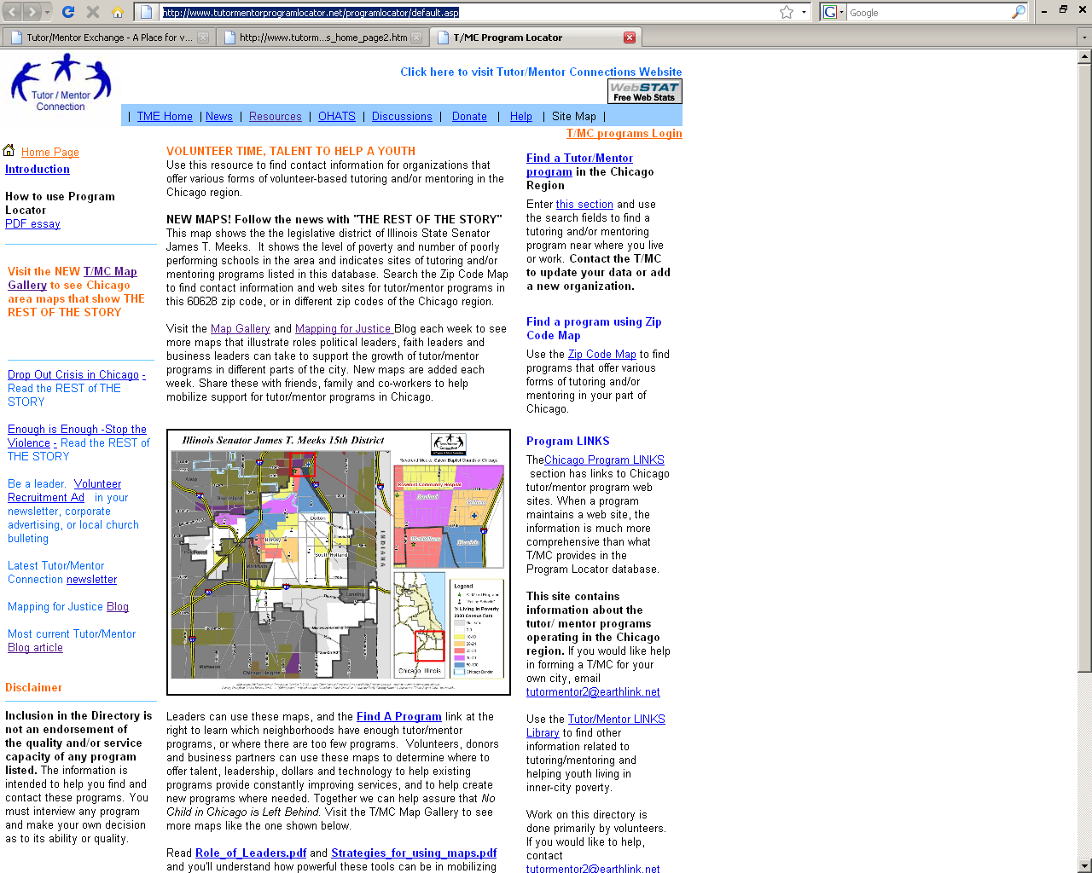
In your mind, will the home page that you are creating be a replacement for this? Of will it be a link off of this? What we are creating should be integrated with what we already have.
Home of Interactive map (Page 1)
Full screen interactive map, showing Chicago region, with boundaries, poverty zones, and poor schools already turned on. Tabs would be as shown
Cities
Chicago
Aurora
Elgin
Waukegan
Aurora
Boundaries
County
Community area
Zip Code
Political
Poverty Levels
0-5%
5-10%
10-20%
20- 40%
Above 40%
All Schools
k-5
6-8
9-12
Colleges
Poor Schools
MESSAGE: Search to find locations and contact information of organizations providing volunteer-based tutor and/or mentor programs.
MESSAGE: Use map to build understanding of level of services in poverty areas, or in different parts of the region.
T/M Programs
Mentor
T/M
Tutor
k-5
6-8
9-12
9am-3pm
3-5:30m
Evening
MESSAGE: Use maps for planning, and building support for tutor/mentor programs
Page 2
MESSAGE: These are organizations who could provide resources (volunteers, dollars, technology, leadership, space, legal/accounting/financial support for tutor/mentor programs in their part of the map
Pre-Formatted maps: Assets
Business
Churches
Colleges
Hospitals
Add yours
. Banks
. Drugstores
. Insurance
. Add
7-9 faith groups

Slide 3
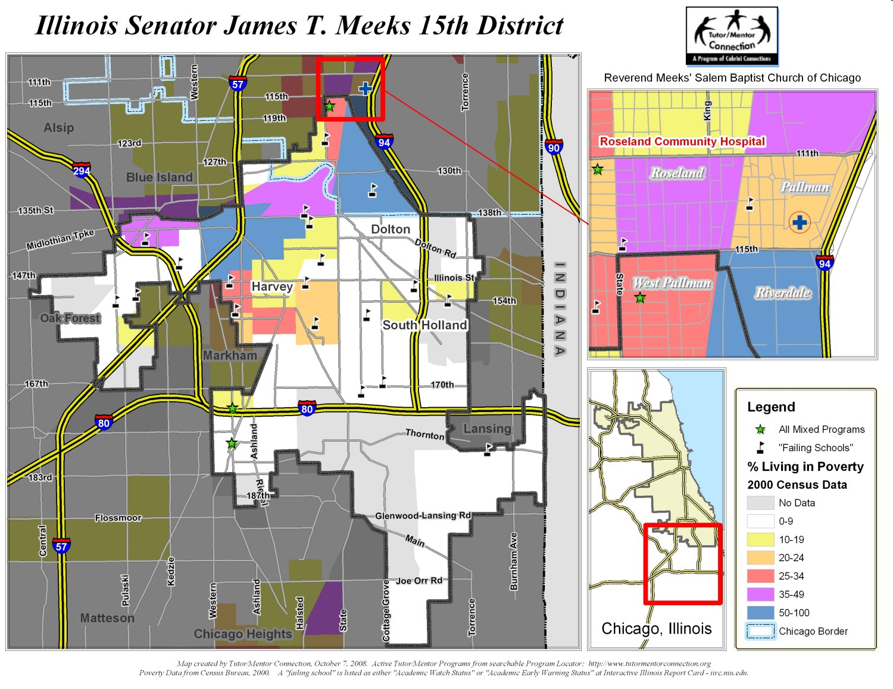
Interactive map org chart: page 3
MESSAGE: Leaders in political districts can provide enabling support
MESSAGE: These are organizations who could provide resources (volunteers, dollars, technology, leadership, space, legal/accounting/financial support for tutor/mentor programs in their part of the map
Page 3
Pre-Formatted maps: Districts
Ill. Leg.
Il. Senate
Congress
Alderman
Define yours
MESSAGE: Maps can draw attention, and resources to places where media cover negative news
MESSAGE: These are maps T/MC has created following stories in Chicago media. They are intended to turn the visibility created by negative news into advertising that draws volunteers and donors to tutor/mentor progrma in these areas.
Page 4
T/MC Maps
Violence
Poor Schools
Conference
Collaboration
Request map
FORMAT: each of the preformatted boxes should have a map view representing the types of maps in that page. When you click on the box, you go to a new page, where the same search features of the HOME page are available, but the boundaries shown on the map, and available as choices, are those that reflect that particular category.

